Slide 1
Findings Lost Revenue:
Documentation Challenges Identified
Day Egusquiza, President, AR Systems, Inc
Alyse Adelstein, President, A3 Revenue Healthcare Consulting

Slide 2
Common Audit Findings Resulting in potential lost revenue
Documentation standards
Lost revenue can come in multiple forms:
Ordered, documented and not billed
Ordered, not documented to match the order, billed incorrectly.
Order does not match the documentation which does not match the bill.
Order is changed after original order but not authenticated by the ordering physician.
Internal guidelines/protocols that do not have orders attached.

Slide 3
Let’s walk thru common audit findings resulting in lost revenue
Drug Administration:
a) manual entries in MAR as free text
b) start and stop times of each bag cannot be found
c) inpt does not allow for billing of Drug adm yet observation is documented as an inpt.
d) no standardized, hard stop entries for nursing to document for ER, Obs, IV outpt infusion, Oncology.

Slide 4
More lost revenue challenges
Drug Wastage: Single dose vials = can bill full vial if the wastage is documented. Where is it? Pharmacy? Pyxis? Oral? Mixed drugs?
Multi dose vials – no wastage can ever be billed. Provider must absorb. (Hot spot: Anesthesia)
Drug dosage/multiplier: Charge masters are needed to ‘do the math.’ The CDM should reflect the lowest common dosage with the multiplier doing the math and posting the correct units. Payment is based on units.

Slide 5
And more
Protocols without orders – CBC ordered; CBC with and without dif done. UA ordered; UA with culture done.
Routine supplies being billed as non-routine. Inpt is never paid separately if paid under DRG. Outpt is seldom paid separately –never by Medicare but other payers could. Ordered as unique to the pt, documented = nonroutine
Routine recovery –up to 6 hrs – in PACU as well as on the floor. Need a flag at the 6 hr mark for nursing to know –what now? Extended recovery?

Slide 6
Better documentation guides within the E H R
Trying to create new documentation systems within a standard E H R to meet the challenges is usually extremely difficult.
Staff responsible for ongoing documentation try hard to document the required elements, but the E H R ‘s functionality is limiting.
Gaining a better understanding of the full functionality of the E HR = BIG WIN!

Slide 7
Closing the GAP
between Audit and
Information Systems

Slide 8
EMR/EHR IV Start & Stop Time
It is imperative for correct billing and coding to have IV start and stop times documentation complete in the EMR/EHR.
Notes:
The documentation dictates the hierarchy of the charging flow for injections and infusions.

Slide 9
Root Cause & Effect
Root Cause & Effect
Start time only
No stop time
No IV cc total
Billed as an injection
Lost revenue
Coded as an injection

Slide 10
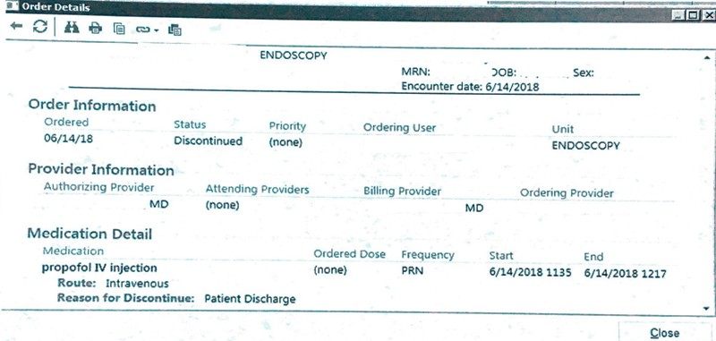
Start n Stop #1
Insert image 1
Notes:
An example of a different area to locate start and stop times. This will help the person charging to chose the correct administration charge.

Slide 11
Start n Stop #2
Notes:
An example in an EMR/EHR of where to see start and stop times in the MAR.

Slide 12
Start n Stop #3
Notes:
A different EMR/HER where IV start and stop times are documented. Again to assist identifying this information so the correct administration charges and be billed.

Slide 13
Medication Wastage
Documentation of medication wastage is often a missed opportunity to recover revenue and reimbursement.
Medication wastage can be found in a Progress Note or MAR, if the person administering the medication documents it.
Lost revenue opportunity with a potential huge dollar impact.

Slide 14
Medication Wastage #1
Notes:
This is an example of medication wastage documented in a progress note. The person creating the charge can capture the charge for administration the medication and the wastage.

Slide 15
Medication Wastage #2
Notes:
A different example where medication wastage can be documented in the MAR. The medical professional is required to enter in the amount wasted. From there, the person can now charge for the wastage as well.

Slide 16
EMR/EHR Medication HCPCS
It is imperative for correct billing and coding to have the correct HCPCS code assignment along with correct unit multiplier in the Charge Description Master in the EMR/EHR.

Slide 17
Root Cause & Effect
Root Cause & Effect
Incorrect HCPCS chosen
Incorrect multiplier in the CDM
Correct HCPCS chosen
Incorrect multiplier in the CDM
Incorrect amount billed
Incorrect amount reimbursed by payor
Lost revenue

Slide 18
HCPCS Multiplier #1
Notes:
This is an example of the HCPCS multiplier required to charge the correct administer medication amount.

Slide 19
HCPCS Multiplier #2
Notes:
Here is a second example, which illustrates a different multiplier that is utilized to charge for the total medication administered amount.

Slide 20
Additional Information
Additional Information System please contact
Ally (Alyse) Adelstein at 424 274 9399 or email: homeytown@hotmail.com
Additional Audit information please contact
Day Egusquiza

Slide 21
Thank you for your time and attention!

Slide 22
Questions and Answers
Contact Info:
Day Egusquiza, President, AR Systems, Inc.
PO Box 2521
Twin Falls, Id 83303
208 423 9036
daylee1@mindspring.com
http://Arsystemsdayegusquiza.com
Be watching for our 7th National PA and UR Boot Camp: Building blocks of contracting, provider sponsored MA plans and the new disruptions. July 2019, Washington, DC. Live and webstreaming

