Slide 1


AR Systems, Inc
Training Library Presents
Attacking Managed Care & Medicare Advantage Anguish –
The New Battleground
CHAPTER 2
Instructor: Day Egusquiza, Pres
AR Systems, Inc

Slide 2

Mgd Care Anguish-
A Brave New World Required-
Payer Policy Changes/Outside the Contract
Significant Growth of Medicare Advantage Plans
= Financial Impact to Providers

Slide 3
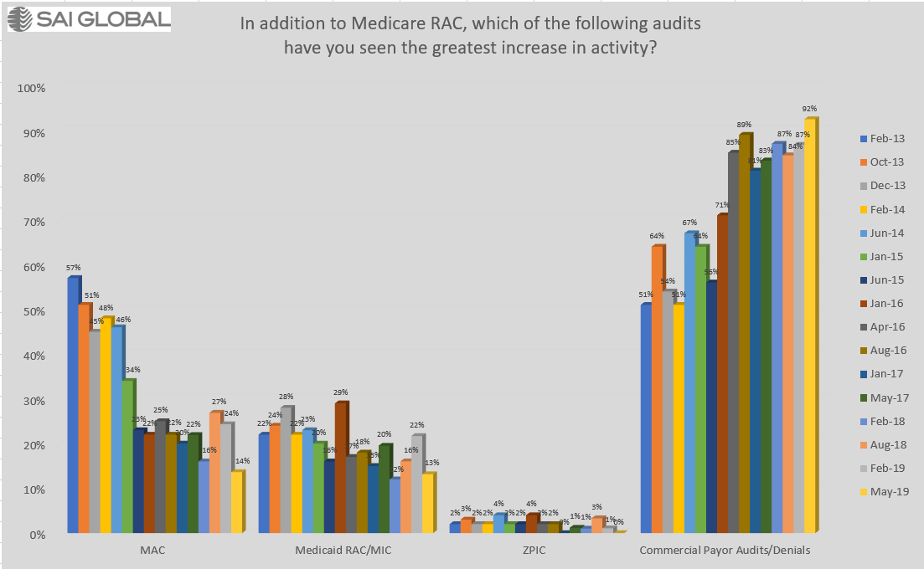
6 year history from Free Webinars SAI GLOBAL 2013-current

Slide 4
Hot off the press – Payer Challenges/Changes/Rulings
‘In big payer win, court sides with UnitedHealth on MA Overpayment Rule” 9-10-18
Federal court sided with UnitedHealth over its challenge of CMS’s Overpayment Rule from 2014.
Judge wrote that CMS doesn’t see more errors or fraud in MA beneficiary charges than those in traditional Medicare. However, the Over payment rule may result in payers getting lower reimbursements while providing the same level of healthcare coverage.
Latest ruling is on a case brought by UnitedHealth and 41 other payers against CMS in 2016 objecting to the overpayment rule penalizing insurance companies for MA overpayments. It state that any dx code not documented in the medical record is considered an ‘overpayment.”

Slide 5
More Hot Updates
UnitedHealth argued that the same level of oversight doesn’t happen with Traditional Medicare.
“This inequity is inevitable because CMS sets MA rates based on costs that are presumed, BASED ON TRADITIONAL DX CODES, to be associated with particular health status information that is not verified in underlying patient records. The same unverified dx is, under the 2014 Overpayment Rule, treated as an overpayment that must be repaid, thus reducing reimbursement to MA plans while requiring no such reduction in payment under Traditional Medicare.”
Meanwhile, multiple insurers have been challenged with claims of Fraud from allegations of inaccurate or misused dx codes. DOJ dropped most of the False Claims Act alleging UnitedHealth used false billing data to increase MA payments.

Slide 6
More ‘hot off the press- CDI”
(Clinical documentation integrity)
Integra filed a False Claims Act lawsuit Aug 10th in the US District Court of Central CA against Providence Health & Services. The lawsuit allege Providence routinely used unwarranted major complications and comorbidity secondary codes on Medicare claims to inflate reimbursement.
According to the 100-pg lawsuit, Integra discovered the unwarranted secondary codes during an analysis of Medicare claims dated back to 2011.
Integra said an investigation of the business practices of Providence and its consultant, clinical documentation improvement company, JA Thomas & Associates, confirmed that Providence’s false Medicare claims were not only intentional but were part of a systematic effort to boost its Medicare revenue.
Pushed doctors to make unwarranted dx and used leading queries.

Slide 7
Short Term Health Insurance – 4 things to know (Becker Hospital Review 8-18)
Administration released FINAL rule for short term health insurance plans/STP. Open ended with coverage.
Previously could only offer 3 months, now can last up to 3 yrs.
1) STP do not have to abide by the rules by the ACA requiring coverage of essential health benefits and pre-existing protection. Nor do they have to abide by insurance plans imposing limits on how much care is covered or the requirement that at least 80% of premium money go toward care.
2) Not abide by ACA, STP do not cover as much as more comprehensive plans. They tend to not cover: maternity, prenatal care, mental health, drug treatment and prescription drugs. May not cover sports injuries and other specific services like cataract treatment, immunizations, and chronic fatigue or pain treatment.
3) Some do not cover $250,000 - $2M. Others only covered inpt on weekdays, others with waiting periods.
4) Generally they are cheaper than the ACA plans. Kaiser study found ex) 40 yr old single man in Atlanta was $371/ACA compared with $47 for STP.
BUYER BEWARE! Less coverage = more out of pocket if healthcare is used.

Slide 8
Medicare Advantage/Part C/MA –increase enrollments
By 2020, it is forecast that Medicare Advantage/MA will constitute 50% of the Medicare market.
Significant changes were made to allow revision/expansion supplemental benefits –like hearing aides, health club memberships, in home visits, home delivered meals, glasses, and others ‘patient specific needs.”
2019 – allow negotiation with pharmacy pricing
Significant payments to plans for “Star Rating’’(4&5) rated by pts.
Limiting out of pocket yearly expense - $6,700 currently
But not all plans are sold in all counties of the country.
No ability to have a Medicare Supplemental – pt pays all out of pocket plus monthly premium.
MA IS NOT TRADITIONAL MEDICARE. Medicare ‘s rules do not apply if the hospital signs a contract. IF NOT CONTRACT, Traditional Medicare rules apply.

Slide 9
Limited knowledge of lack of benefits - MA
MA plans are ‘county’ specific within a state
Only certain plans are sold in certain counties
“Community coverage” with the MA plan
Therefore, if the pt needs care that is not within their ‘community’ ( Pt needs care outside their local community) - Out of network potential penalties. Exception – all Emergency care is covered. Just not after treatment care or ongoing care. (Snow birds-NO)
Provider networks- MA plans cannot sell in your community unless they have a provider network.
To contract or not to contract- what does the provider get for accepting less than billed charges? Win for payer, win /baby win for provider is??
General enrollment – 1x yr; opt out thru March yearly.

Slide 10
Why would a patient select MA over Traditional Medicare?
Part B = monthly premium/out of SS monthly Check. $130 monthly
Part D = monthly premium/sold by insurance/but required. $80 monthly
To cover co-pays and deductibles = Medicare Supplemental insurance. $180 per person/insurance co
No cap on out of pocket costs with Traditional
Traditional Medicare = Approx $390 per person
MA plans = collapse Part A,B, D into 1 monthly premium. Usually much less than Traditional fees.
Some MA plans are not charging ANY Monthly premiums.(United/AARP) Each plan can develop their own package…
MA plans are paid a per-member, per month for all signed up patients. No additional funds with inpts.

Slide 11
Risk adjustment data validation RADV-Medicare Advantage Plans
The diagnoses that PacifiCare submitted to CMS for use in CMS’s risk score calculations did not always comply with Federal requirements. For 55 of the 100 beneficiaries in our sample, the risk scores calculated using the diagnoses that PacifiCare submitted were valid. The risk scores for the remaining 45 beneficiaries were invalid because the diagnoses were not supported by the documentation that PacifiCare provided.
As a result of these unsupported diagnoses, PacifiCare received $224,388 in overpayments from CMS. Based on our sample results, we estimated that PacifiCare was overpaid approximately $423,709,068 in CY 2007. (settled in 2017)

Slide 12
GAO Slams CMS on MA Audits
GAO found that CMS's methodology does not result in the selection of contracts for audit that have the greatest potential for recovery of improper payments.
CMS's goal of eventually conducting annual RADV audits is in jeopardy because its two RADV audits to date have experienced substantial delays in identifying and recovering improper payments.
CMS has not expanded the recovery audit program to MA by the end of 2010, as it was required to do by the Patient Protection and Affordable Care Act. GAO-16-76 Published: Apr 8, 2016
UPDATE: Medicare Failed to Recover Up to $125 M in Overpayments, records show. 1-6-17
“Under intense pressure from the health insurance industry, CMS quietly backed off their repayment demands and settled the audits in 2012 for just under $3.4 M – short changing taxpayers by up to $125M in possible overcharges just for 2007!” http://khn.org/news/Medciare-failed-to-recovery-up-to-125-million-in-overpayments-records-show/?utm_campaign

Slide 13
Mgd Care Anguish-
A Brave New World Required-
Attacking DRG Downgrades, Pt Status Disputes,
Re-Admission Denials…

Slide 14

3 Legs of Anguish – Pt Status, DRG Downgrades, Re-Admissions
Pt Status – what is their definition of an inpt?
DRG Downgrades – what documentation standards are required to allow all physician inclusion of ALL dx the pt has and are included in the thought process/not always the actual treatment?
Readmissions - Related means? 30 days when CMS does not use this standard. Preventable means?
Hint – all must be in the contract! Usually silent.
Look to operational addendums vs
Payer –specific policies… UGLY

Slide 15
DRG Downgrades
Lots of discussion regarding tying in the diagnosis outlined to the treatment. Simply listing dx is not sufficient to ‘earn the higher DRG payment.”
Differing interpretations of ‘co-morbid’ conditions.
Differing interpretations of ‘primary and secondary ….reasons for admit.’ Different DRG assigned.
Peer 2 Peer/P2P calls..always!

Slide 16
Challenges with DRG & Coding
Payment is based on a dx based DRG payment.
Challenges with the providers tying in all diagnoses as part of the clinical pathway
Payers are requesting records for multiple co-morbid conditions that drive up the DRG payment.
Track and trend requests, outcome, with action items attached.
What does the contract state regarding record requests? Volume? Reason?

Slide 17
Massive Requests for Records
First: If contracted, what does the contract state regarding request? Volume? Frequency? Reason? ALWAYS validate with each request. (EX: NY health system)
Second: If no contract, why send the records? If MA plan with no contract, what would ‘traditional Medicare do’ with the same issue? Threats to not pay or recoupment payment. IMMEDIATELY report to CMS /abuse.
Third: Track and trend all requests. Why? What is the finding? Report to contract management ASAP.
Fourth: HIPAA Standard Transaction and Privacy (2003ish) – only send ‘minimally necessary information.’ Never the full record. If prior authorized (all are) – then why do they need the record POST care?

Slide 18
One RAC Relief User Issue- Lost Medical Records??
Sending appeals and then following up to check the status only to learn they don't have any record of us filing an appeal and we will need to resend it to them.
Suggested Response: Would you like me to contact the Office of Civil Rights and file the HIPAA breach report for you since you lost PHI that I can prove was in your possession? **

Slide 19
Medicare Advantage – Provider WINS – use regulations
“If the plan approved the furnishing of a service thru an advantage determination of coverage, it MAY NOT deny coverage later on the basis of a lack of medical necessity.” Medicare Mgd Care Manual/Medical Necessity, Chpt 4.
2 MN required for MA plans. “Each MA organization must meet the following requirements: a) provide coverage by furnishing, arranging for or making payment for, all services that are covered by Part A and Part B of Medicare ..that are available to beneficiaries residing in the plan’s service areas. Services may be provided outside of the service area of the plan if the services are accessible..2) General coverage guidelines included in original Medicare manuals and instruction, unless superseded by regulations .. 42 CFR, subpart C, 422.101.” MA plans must comply with NCD and Guidelines.

Slide 20

Specifics – Disputes with payers
Internal MD to Payer’s MD
Do more Peer to Peer calls- preferred Internal Physician
  Get involved
  Educate front line attending-documentation enhancements
  Let them know what is in question
  Share with all
  Think internal Physician Advisor to effect change internally
  BIG: Healthplans (Humana) are including language about ‘providers treating pt’
  BIG: No longer do post-denial calls. Only concurrent. 9-18 (POLICIES)
Notes:
If already peer to peer has been done and approved , can you avoid a second look / audit?

Slide 21
It’s all in the Contract or is it
Policy-outside the contract?
United Health Care Policy Number: H-006
Coverage Statement: Hospital services (inpatient and outpatient) are covered when Medicare criteria are met. **DANGER ZONE***
For coverage to be appropriate under Medicare for an inpatient admission, the patient must demonstrate signs and/or symptoms severe enough to warrant then need for medical care and must receive services of such intensity that they can be furnished safely and effectively only on an inpatient basis.

Slide 22

Medicare Advantage/MA plans ‘using Traditional Medicare’ to their advantage..
Part A rules only apply if contracted.
  “Can’t change status after discharge.” HUGE! Many disputed statuses are not resolved until after discharge. Ensure this is allowed in contract language.
  EX) Humana IS imposing no change of status after D/C. HUGE win for Humana as disputed status may involve P2P calls – which can take days to coordinate…pt is discharged with a disputed status… NO !
  “Condition Code 44 has to be done” HUGE! Since Part C Medicare has to be contracted for status confirmation, it is not applicable unless contractually included.
  Managed Part C plans ‘quote’ CC 44 for disputed status – inpt back to obs. Again, unless it clearly states that CC 44 is part of the contract – it is not used. HUGE win for the payer as disputes can take days to resolve – SO pt is an inpt until dispute is resolved. DO NOT Allow – ‘we follow CMS guidelines’ without additional clarity.

Slide 23
Update – United =25% market share
As of Aug 2015, UHC no longer uses the CMS two-midnight standard to make inpt admission determination.
UHC believes the best way to help UHC’s members get access to the care they need is to relay on evidence-based guidelines and treatments. Evidence-based guidelines allow UHC to review a member’s health condition based on the clinical documentation and provide consistent, clinically validated decisions for hospital admissions.
More specifically, United uses Milliman Care Guidelines (MCG) to determine medical necessity and the appropriate level of care.
UHC will also provide a copy of MCG criteria upon request before, during, or after a reconsideration request.
Sites should now consider: “If appeal results in an adverse decision, we request a copy of the individual criteria used to determine medical necessity be provided with the determination.”
Per UHC 2016 Provider Manual – pp 113-114 Criteria for Determining Medical Necessity.

Slide 24
Non-Participating update –United
Applies to Medicare Mgd/Advantage and Commercial
New Regional Director for SC- updated change in policy toward non-participating facilities and the loss of ability to interact with United.
Non-Par will no longer have any cases concurrently reviewed.
Peer to Peer discussions will no longer be available (no concurrent)
All cases will be retrospectively reviewed by Change Healthcare/EquiClaims and Cotiviti –who United contracts with to do their reviews.
Initial appeals will have to go to whichever contractor issued the denial and if the appeal is signed by a physician –then it will be reviewed by a Medical Director. Otherwise you will have to appeal up to 3 X to the contractor to eventually have it reviewed by the Medical Director after which you would have one chance to appeal to United but no guarantee of Medical Director involvement.
Non-par facilities still required to notify United of an admission but they will no longer be allowed to submit any clinical information since no concurrent review will be allowed.
Watch addresses on denial letters… could be wrong – miss deadline.
*Thanks, Dr. Baker, Self Regional Healthcare* 7-17

Slide 25
Payer‘mis-information’ for Medicare Advantage plans
“Recently we received a denial for a status 3 years after the encounter. The pt was here for an OP Hemorrhoid procedure developing vomiting with distension of a colonic ileus. History of Olgilvie syndrome failed 48 hrs of outpt treatment. Inpt was approved thru payer contact prior to billing/3 years ago. Now the 3rd party vendor is stating he did not meet inpatient criteria.”
Medicare Managed Care Manual, Cpt 4, Section 10.16. And Program Integrity, Cpt 6, Section 6.1.3 Medical necessity applies:
“If the plan approved the furnishing of a service thru an advance determination of coverage, it may not deny coverage later on the basis of a lack of medical necessity.” YAHOO!
Turn in abuse to CMS – as oversight for all MA Plans.

Slide 26
More payer anguish -Place of service Audits
“One carrier has enlisted HDI to audit place of service. They sent us 10 cases, all Medicare Advantage, DOS vary from 2016-2018, only one case had a 1 day LOS and they all say the same thing: “The patient could have been safely and appropriately cared for in an outpt level of care.” Now that sounds like a medical necessity denial to me. The kicker? I have already been denied 4 of these cases (back in 2016 and 17) and one was overturned by peer to peer, the other three were overturned on written appeal. How can this be possible? “ Western Conn. 8-18
SEE PG 18. It can’t! But think of the wasted administrative costs to continue to a) track, b) defend and c) repeat defend. Track and trend and turn all costs into Contracting.

Slide 27
More payer anguish - Outpt
“For the last month or so, we have been getting letters from UHC wanting the medical records on all our outpt services and even if they are the 2nd payer and owe us under $100, they want the records. They are asking for records for a simple CBC, strep test, drug screening, mammo,and colonoscopies. In many cases, it is costing us more to send them the medical record than what our actual reimbursement would be. I filed a complaint with our UHC Advocate and we have a phone call set up. They are calling it “pre-payment letters.’ In many cases we have a prior authorization and they are still wanting the complete medical records. Now other payers are starting to do the same thing.” Ill small hospital
Most are commercial UHC and we are contracted..
No idea why we would agree to this but under PROTOCOL, we have to respond.

Slide 28

CMS making changes – impacts all payers?
Physician E&M office visit leveling system
“CMS is proposing to move from a system with separate documentation requirements for each of the 4 levels that physicians use to a system with just one set of requirements and one payment for all new and a different payment for all established. (Level 1 is primarily used by nonphysician practitioners.)
Most specialties would see changes in their overall Medicare payments in the range of 1-2% up or down but we believe that any small negative payment adjustment would be outweighed by the significant reduction in documentation burden.” Seema Vera 7-18
Proposed $: New: L1 $45; Levels 2-5 $135 *more for 2-3; less for 4-5
Proposed $: Established L1 $22; Levels 2-5 $93 *more for 2-3; less for 4-5.
All provider groups would receive the same payment (??Other payers??)
UPDATE: 170 groups commented – only liked 3 things of the proposed change:
  Redocument info already in the hx; remove requirement to justify home visit rather than office visit; revising to focus on hx since last visit.

Slide 29
More Payer-Provider Challenges -Cigna
No longer paying drug administration
Effective 5-19: Reimbursement policy for infusion and injection.
“We routinely review our coverages, reimbursement and administrative policies… In that review, we take into consideration one or more of the following: evidence-based medicine, professional society recommendations, CMS guidance, industry standards and our other existing policies.”
‘As a result of this review, we want to make you aware that we will NO LONGER SEPARATELY REIMBURSE infusion and injection administration services billed by facilities because infusion and injections administration services are considered INCIDENTAL TO THE PRIMARY SERVICE and are not separately reimbursable.”
“The affected CPT codes: 96360-96379 and 96521 thru 96523. This aligns with our current reimbursement poslicies for facility routine supplies. (EXCLUDES: Chemo 96400-530 and sub-inj 96372)
NOTE:” In Nov, 2018, we began applying this update to claims from the ER DEPARTMENTS. This updates expands to all areas within a facility.” (No observation or ER. What if have chemo and non-chemo drugs at the same treatment time?)
WOW! A) What is the primary service that is being paid? B) If it is drugs, are you getting full billed charges as it must now cover all visit and all infusion costs C) What about the ER visit or HBC visit?
29

Slide 30
Payers /Physicians– “Really really hate Prior Authorizations/PA” -
AMA survey 3-18
New survey of American Medical Association –examined the attitudes of 1,000 physicians regarding prior authorization.
Insurance companies: As an effort to deliver the best possible therapy to the patient and to avoid unnecessary care.
Physicians: Simply a tactic to make expensive care more onerous, driving down the costs to the insurance companies.
Q: How would you describe the burden: 84% very high.
86% report that the burden has increased over the past 5 yrs.
79% reported having to repeat prior auths even for pts previously approved.
Ins requests prior auths 29.1 x per week.
78% reported that PA can at lead to treatment abandonment.
Dedicate an average of 14.6 hrs per week for Prescription and medical services per practice = 2 business day.
UPDATE: CMS wants to eliminate faxes by 2020 and replace with digital. 90% of payer communications done by phone or fax. Could save $3.20 to $3.64/transaction if moved to fully electronic prior authorization. While prior auth applies to less than 15% of covered services, there is a need to simplify. (9-18 Himss/Susan Morse, Senior Editor)

Slide 31
Readmissions- CMS Policy
When a patient is discharged/transferred from an acute care Prospective Payment System (PPS) hospital and is readmitted to the same acute care PPS hospital on the same day for symptoms related to, or for evaluation and management of, the prior stay’s medical condition, hospitals will adjust the original claim generated by the original stay by combining the original and subsequent stay onto a single claim. Please be aware that services rendered by other institutional providers during a combined stay must be paid by the acute care PPS hospital as per common Medicare practice.

Slide 32
30-Day Readmission CMS
CMS Hospital Readmissions Reduction Program (HRRP)
Section 3025 of the Affordable Care Act added section 1886(q) to the Social Security Act establishing the Hospital Readmissions Reduction Program, which requires CMS to reduce payments to IPPS hospitals with excess readmissions, effective for discharges beginning on October 1, 2012. The regulations that implement this provision are in subpart I of 42 CFR part 412 (§412.150 through §412.154).
In the FY 2012 IPPS final rule, CMS finalized the following policies with regard to the readmission measures under the Hospital Readmissions Reduction Program:
Defined readmission as an admission to a subsection (d) hospital within 30 days of a discharge from the same or another subsection (d) hospital;
Adopted readmission measures for the applicable conditions of acute myocardial infarction (AMI), heart failure (HF), and pneumonia (PN).
In the FY 2014 IPPS final rule, CMS finalized the expansion of the applicable conditions beginning with the FY 2015 program to include:
  (1) patients admitted for an acute exacerbation of chronic obstructive pulmonary disease (COPD); and
  (2) patients admitted for elective total hip arthroplasty (THA) and total knee arthroplasty (TKA).
In the FY 2015 IPPS final rule, CMS finalized the expansion of the applicable conditions beginning with the FY 2017 program to include patients admitted for coronary artery bypass graft (CABG) surgery.

Slide 33
United Health Care Readmission
A LVN, LPN or RN will review the medical records and supporting documentation provided by the facility to determine whether the two admissions are related.
If the subsequent admission is related to the initial admission and appears to have been preventable, the LVN, LPN or RN will submit the case to a medical director, who is a physician, for further review.
The medical director will review the medical records to determine if the subsequent admission was preventable and/or there is an indication that the facility was attempting to circumvent the PPS system. **
Aetna MD/CA case in court: did not do review of case/just read recommendation by clinical team. AG’s investigating
FULL DENIALS of the 2nd admission by MA PLANS…and other COMMERCIAL PAYERS…

Slide 34
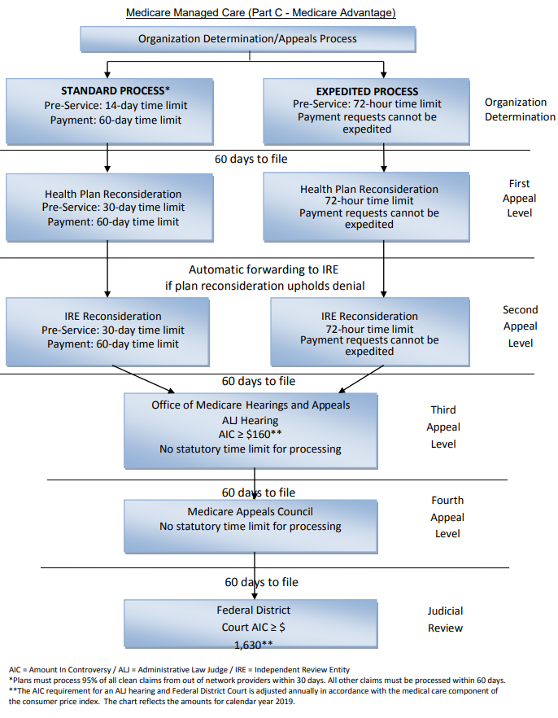
MA Appeals Process
Enrollee (beneficiary) appeal rights shown
Non-contract providers may access standard payment appeal pathway if waiver of liability completed
Anyone with formal representative authority can access full enrollee appeal rights without waiver of liability
Note automatic forwarding to IRE if first level reconsideration upheld

Slide 35
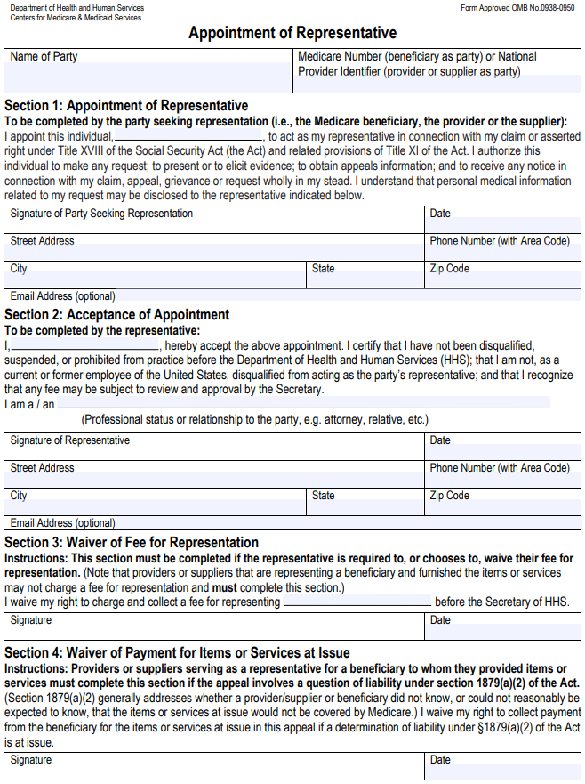
CMS Form 1696 – formal representative
Must be accepted by all Medicare Advantage plans – cannot require a different form
Sections 4 not applicable to Medicare Advantage because the Plan’s Evidence of Coverage dictates any cost-sharing responsibility, unchanged by this form
Providers cannot charge a fee for representing enrollee
Valid for 1 year, and for life of an appeal

Slide 36
CMS Contacts for Specific Plans and General Contact
Humana MED C Contact at Medicare:
Uvonda Meinholdt
Health Insurance Specialist
Kansas City Regional Office
Phone: 816-426-6544
FAX: 443-380-6020
Uvonda.Meinholdt@cms.hhs.gov
UHC MED C Contact at Medicare:
Nicole Edwards
Phone: 415-744-3672
Nicole.edwards@cms.hhs.gov
Coventry Health Care Med C/Aetna Med C
Donald Marik
Health Insurance Specialist
Denver Regional Office
Phone: 303-844-2646
Donald.Marik@cms.hhs.gov
Blue Cross Blue Shield Anthem Med C:
Anne McMillan
Health Insurance Specialist
Chicago Regional Office
Phone: 312-353-1668
Anne.McMillan@cms.hhs.gov
General CMS Contact:
Melanie Xiao
Health Insurance Specialist
Medicare Advantage Branch
Division of Medicare Health Plans Operations
Centers for Medicare & Medicaid Services
CMS San Francisco Regional Office
90 7th Street, 5-300 (5W)
San Francisco, CA 94103-6708
Phone: 415-744-3613
FAX: 443-380-6371
melanie.xiao@cms.hhs.gov

Slide 37
Success stories of filing a MA complaint. *80 bed Ill hospital* SQUEAK
Last Nov, filed complaint with Medicare C Advocate.
Two were against Aetna and two were against United Healthcare.
Surprise – Aetna settled with us within 30 days after receiving the complaint. UHC –another matter.
They were cooperating and then suddenly, would not return phone calls or send a letter stating why they had not paid.
Both accts were behavioral health and over a year old.
Told –don’t reply, they will file another complaint- done in March.
15 days after the 2nd complaint, both accts were paid, not only that, they were paid with interest. NO MA CONTRACT so traditional Medicare rules apply. (i.e. 60 days = interest)
AND the Part C Advocate told them they had to send a letter explaining what happened and why it took so long to remedy.

Slide 38
Regulations 42 C.F.R. § 422.214
If non-contracting with a MA plan….
§ 422.214 Special rules for services furnished by noncontract providers.
Services furnished by non-section 1861(u) providers.
  Any provider (other than a provider of services as defined in section 1861(u) of the Act) that does not have in effect a contract establishing payment amounts for services furnished to a beneficiary enrolled in an MA coordinated care plan, an MSA plan, or an MA private fee-for-service plan must accept, as payment in full, the amounts that the provider could collect if the beneficiary were enrolled in original Medicare.
  Any statutory provisions (including penalty provisions) that apply to payment for services furnished to a beneficiary not enrolled in an MA plan also apply to the payment described in paragraph (a)(1) of this section.
Services furnished by section 1861(u) providers of service. Any provider of services as defined in section 1861(u) of the Act that does not have in effect a contract establishing payment amounts for services furnished to a beneficiary enrolled in an MA coordinated care plan, an MSA plan, or an MA private fee-for-service plan must accept, as payment in full, the amounts (less any payments under §§ 412.105(g) and 413.76 of this chapter) that it could collect if the beneficiary were enrolled in original Medicare. (Section 412.105(g) concerns indirect medical education payment to hospitals for managed care enrollees. Section 413.76 concerns calculating payment for direct medical education costs.)

Slide 39
Proactive Strategies – Contracts or Addendum to contract or Policy ‘hits.’
GOAL: It is a internal team sport
Develop a template for terms for all payers – commercial and Medicare Part C/Advantage –beyond payment.
Areas to include:
  Timeline to submit clinicals – inpt vs obs
  Timeline for determination from the payer- within 12 hrs
  Immediate call/appeal including guarantee of a peer to peer call within 24 hrs with clear time assigned and kept.
  Clearly outline criteria being used to determine inpt status. (Beyond ‘medically necessary ‘ care.)
  DRG – Correct coding guidelines being used. (Disallowing dx that are not being treated…lower the DRG payment.)
  Re-admission guidelines. (Related? Like CMS?)
  Appeal rights – post discharge. Ensure all 5 levels with Traditional Medicare are included for all Part C plans.
  “Using Traditional Medicare/CMS” rules – but what happens when they don’t?
  Build Addendums to contracts – outlining the operational aspects of the contract

Slide 40
And the financial ‘hit from all of these payer ‘rules’-
“Morgan Stanley analysis: “450 hospitals at risk of potential closure.” More than 15% of US hospitals have weak financials. Additionally, their analysis showed 600 were ‘weak’ based on criteria for margins before interest and other items. 8-18
BCBS of TN to drop OxyContin coverage. Cigna removed OxyContin from its list 1-18.
“Cleveland Clinic’s operating income plunges 80% in Q2.” Created Affordability Task Force in 2013. Saw increase in salary, benefits, as well as pharmaceutical and supply costs. 8-18
Hospitals operating margins dropped 39% in 3 years. Why: Expenses grew by 3 percentage points faster than revenue. Unsustainable. 9-18

Slide 41
Complexity from all directions- Patients impacted
Patients unaware they are ‘seamlessly converted ‘ to the Mgd Medicare Plan when they had the same carrier as a Commercial plan. HOLY MOLY!
See www.washingtonpost.com/national/health-science/senior-surprise-getting-switched-with-little-warning-into-Medicare-advantage/2016/07/26.
Patients received letter /one of many as they approach 65. They MUST opt OUT of the plan or they are seamlessly being enrolled. “With Medicare’s specific approval, a health insurance company can enroll a member of its marketplace or other commercial plan into its Medicare Advantage plan…which takes effect within 60 days unless the member opts out.”
Many pts without their doctor and more money out of pocket as didn’t know they were part of a Mgd Plan!!!

Slide 42
BREAKING NEWS - HOLD
Oct 24, 2016 CMS has temporarily stopped accepting new proposals from health insurance companies seeking to automatically enroll their commercial or Medicaid patients into their Medicare Advantage/Part C plans.
CMS disclosed 29 Medicare Advantage companies – including Aetna, United, and several Blue Cross and Blue Shield insurers. Half of the companies received their approval this year.
Members currently are AUTO enrolled unless they opt out.
Dialogue want the pts to OPT IN..so they have choice. Doctor relationships are huge when the pt is AUTO enrolled.
www.modernhealthcare.com/assets/pdf/CH1075661021.pdf
www.modernhealthcare.com/article/20161004/news/161009981

Slide 43

AR Systems’ Contact Info
Day Egusquiza, President
AR Systems, Inc
Box 2521
Twin Falls, Id 83303
208 423 9036
daylee1@mindspring.com
EXCITING! Save the date: 7th National PA & UR Boot Camp:
“Medicare Advantage: Building blocks of contracting, Provider sponsored MA plans and the Ongoing denial challenges.”
PLUS Pre-con: “The Basics: Medicare 101, P2P 101, CDI 101, and Denials/Appeals 101”.
WOW! July 29-31, 2019 Washington , DC
In person plus live web streaming…
NEW EXPANDED WEBPAGE: http://arsystemsdayegusquiza.com

